Slide 1

Classifying the Circuit De-obfuscation Runtime based on Learning Methods and K-means Clustering
Seventh Presentation

Slide 2
Main steps for developing a classification scheme for de-obfuscation runtimes
Applying K-means clustering to the de-obfuscation runtimes with different number of clusters
Assigning labels to each sample based on the best number of clusters.
Training, validating, and testing the CNF-Net model
Extracting scaler and vector features from each sample and selecting the best scaler features
1
2
3
4

Slide 3
Step 1: K-means clustering and choosing the best K

Slide 4
Step 1: K-means clustering and choosing the best K
For applying K-means clustering and choose the best k, We took two approaches
Manually change the K value and investigate the results
Determining the best k using elbow technique

Slide 5
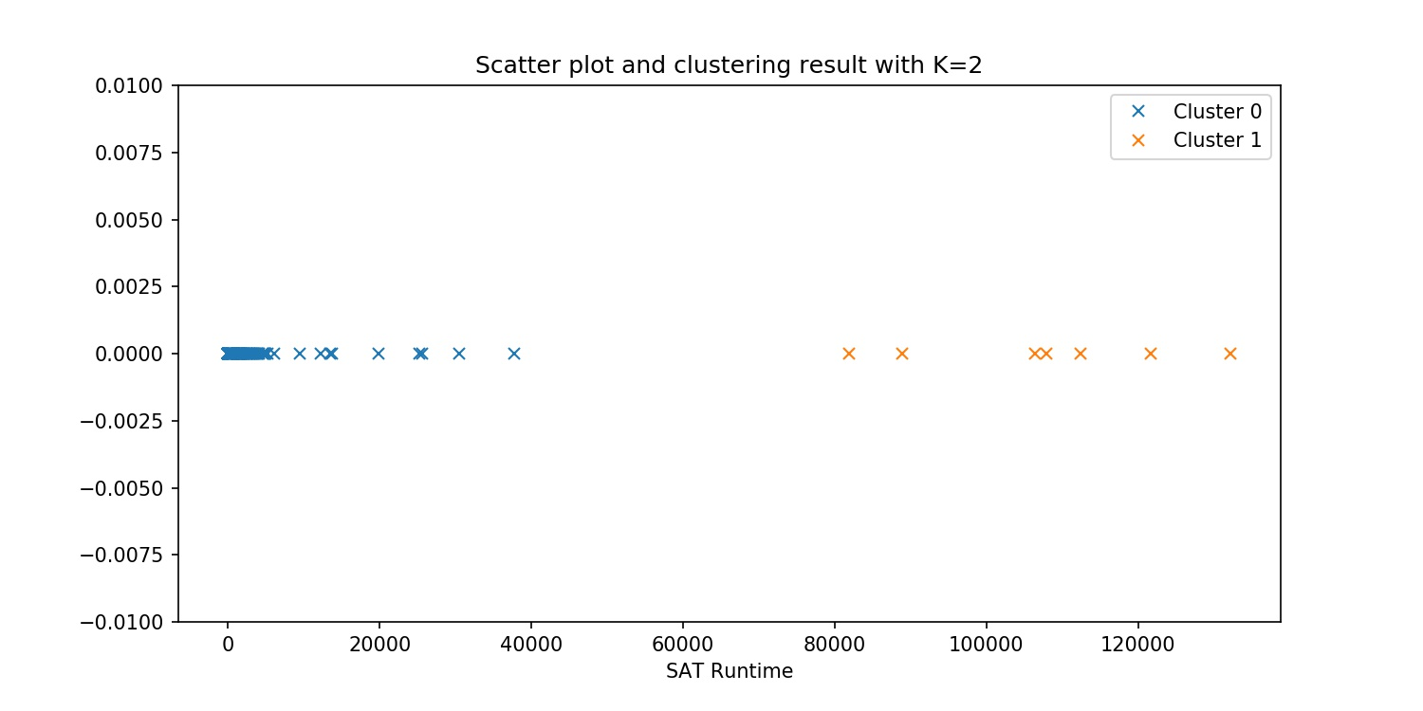
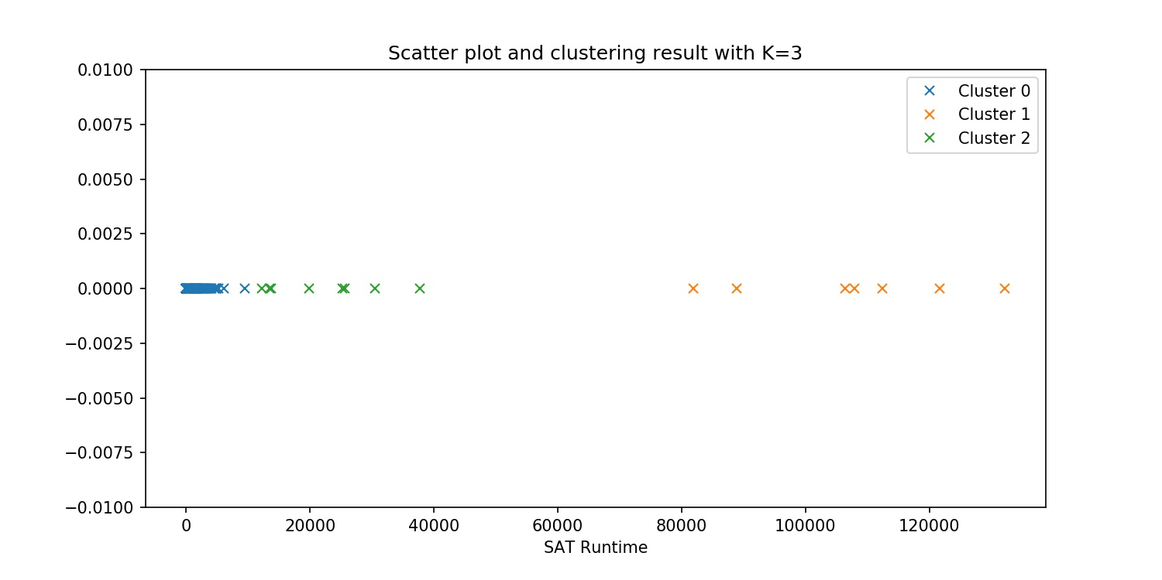
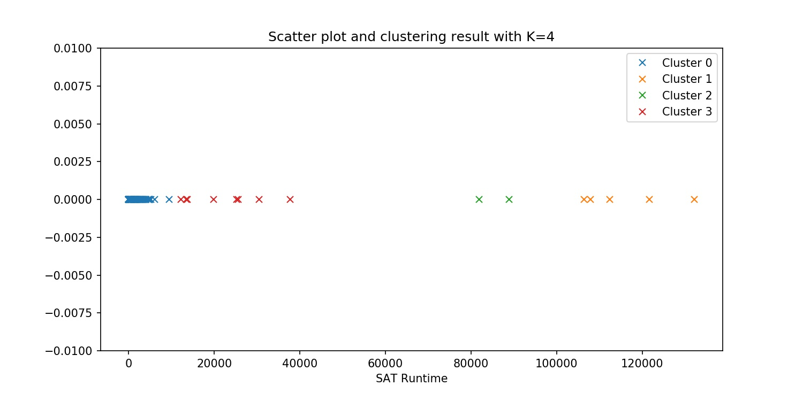
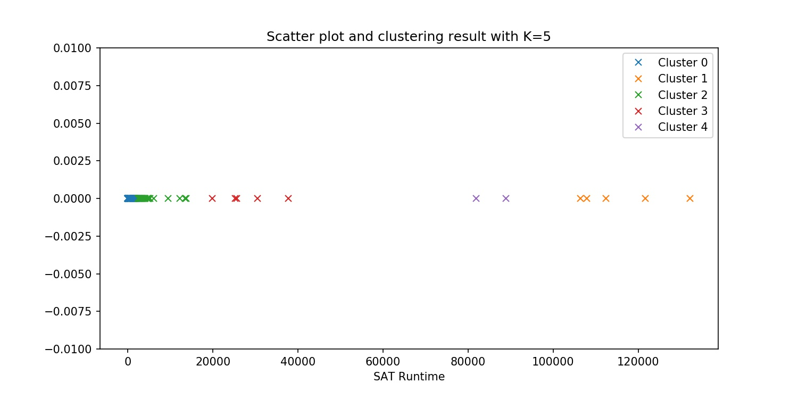
Step 1: K-means clustering and choosing the best K
Manually change the K value and investigate the results
According the results, we determined K=3 is the best number of clusters for de-obfuscation runtime

Slide 6
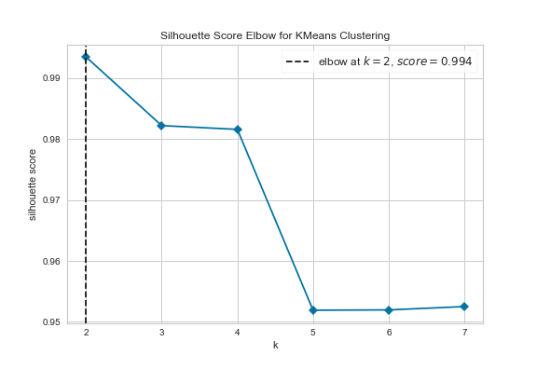
Step 1: K-means clustering and choosing the best K
Determining the best k using elbow technique
Based on elbow technique result, the K=2 is the best number of clusters

Slide 7
Step 1: K-means clustering and choosing the best K
Final Decision
According to the significant separability between 3 clusters, we select 3 as the best number of clusters

Slide 8
Step 2: Assigning labels to each sample based on the best number of clusters

Slide 9
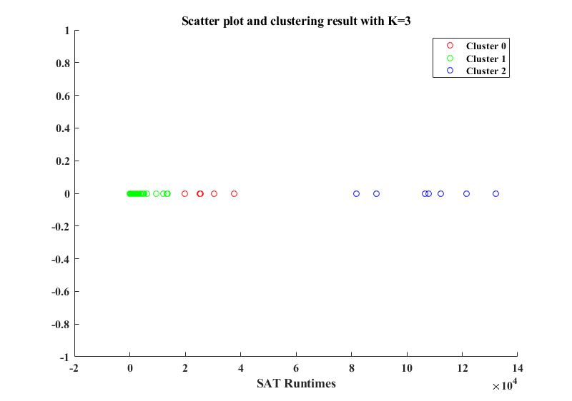
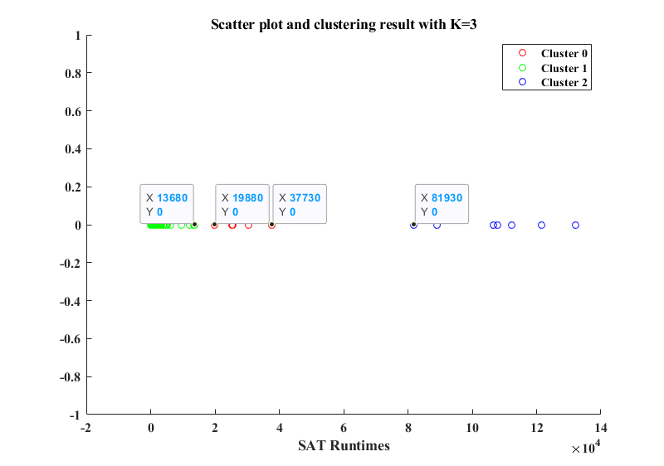


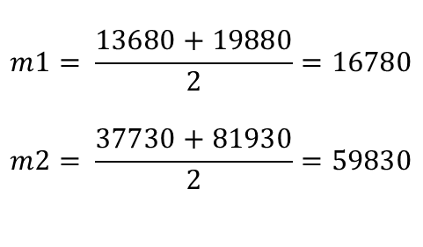
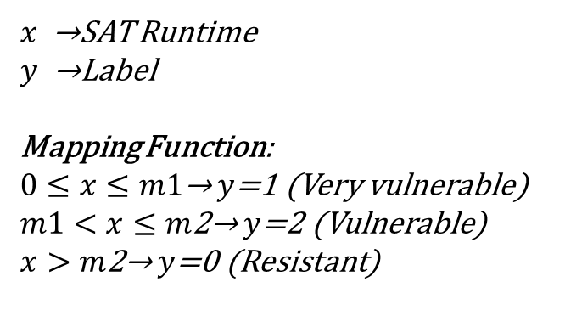
Step 2: Assigning labels to each sample based on the best number of clusters
Final decision for choosing the best K and the best margins
$$m1= \frac{13680+19880}{2}=16780$$
$$m2= \frac{37730+81930}{2}=59830$$
$$m1$$
$$m2$$
$x$ →SAT Runtime
$y$ →Label
Mapping Function:
$0≤x≤m1\text{→}$ $y$=1 (Very vulnerable)
$m1<x≤m\text{2}\text{→}$ $y$=2 (Vulnerable)
$x>m\text{2}\text{→}$ $y$=0 (Resistant)

Slide 10
Step 3: Assigning labels to each sample based on the best number of clusters

Slide 11
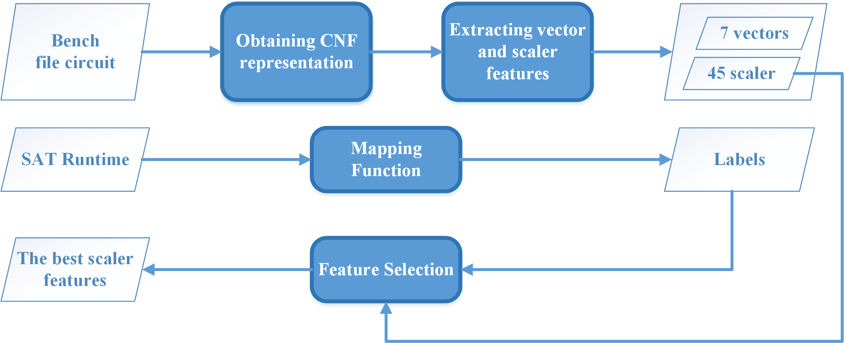
Step 3: Extracting scaler and vector features from each sample and selecting the best scaler features

Slide 12
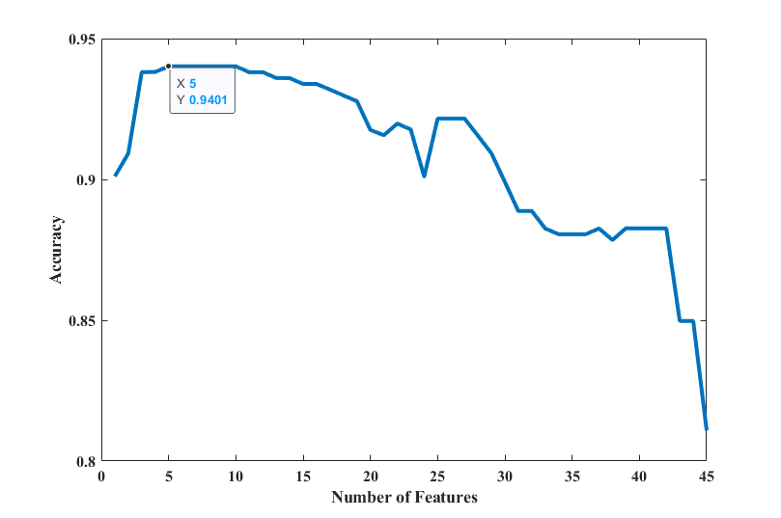
Step 3: Extracting scaler and vector features from each sample and selecting the best scaler features
Feature selection result
We used sequential forward feature selection (SFFS) as the feature selection algorithm
The classifier of the SFFS is K-nearest neighbor (KNN)
5 features were selected from 45 features

Slide 13
Step 4: Training, validating, and testing the CNF-Net model

Slide 14
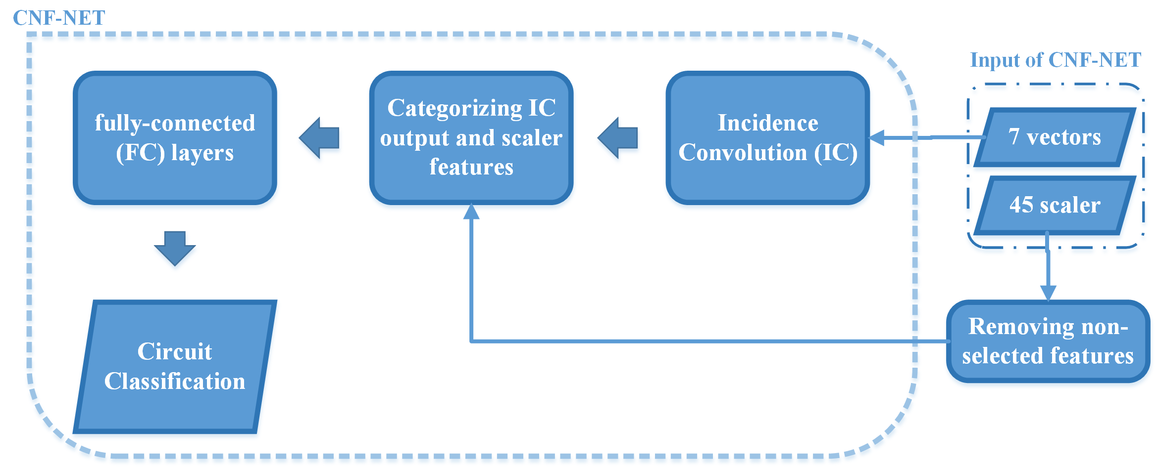
Step 4: Training, validating, and testing the CNF-Net model

